Slide 1


Name:ANIKET SENAPATI
REGISTRATION NO.2305260003
4TH SEMISTER

Slide 2
Introduction to TECH TREKKER
Decode the Future. One Innovation at a Time.
In a world where technology moves faster than ever, Tech Teckker is your go-to hub for staying informed, inspired, and ahead of the digital curve. We’re not just another tech blog — we’re a community of thinkers, tinkerers, creators, and visionaries who live and breathe technology.Whether you’re fascinated by artificial intelligence, curious about the latest smartphones, obsessed with futuristic gadgets, or diving deep into coding and cybersecurity — you’ll find a home here.
At Tech Teckker, we bring you:
In-depth reviews of the newest tech gear and tools
Fresh takes on emerging trends and industry shifts
Explainers that simplify complex topics in AI, blockchain, cloud computing, and more
How-to guides & tutorials for beginners and pros alike
Weekly tech roundups, opinion pieces, and future forecasts
Our goal is simple: to make technology more accessible, understandable, and exciting — no jargon, no fluff — just real, relatable content for real tech lovers.So whether you're a curious reader or a full-blown technophile, welcome to the future. Welcome to Tech Teckker.

Slide 3
content
1.Objective
2.Key Features
3.System Requirement
4.Tools and Technology
5.ER Diagram
6.benfits
7.Screenshot of TECH-TEKKER
8.Future Enhancements
9.Challenges and solution
10.Security features
11.Conclusion

Slide 4
OBJECT OF THE PROJECT
The primary objective of Tech Teckker is to create a dynamic, informative, and user-friendly technology blog platform that serves as a one-stop destination for all things tech. The project aims to:
Educate and Inform – Provide up-to-date, accurate, and insightful content on the latest advancements in technology, including gadgets, software, hardware, AI, cybersecurity, and more.
Simplify Complex Tech – Break down technical topics into easy-to-understand articles and tutorials for a wide range of audiences — from beginners to advanced users.
Build a Tech-Savvy Community – Encourage discussion, sharing of knowledge, and collaboration among tech enthusiasts, professionals, and learners.
Stay Ahead of Trends – Deliver early insights and analysis on emerging technologies, helping readers understand the potential impact on industries and daily life.
Empower Decision-Making – Offer honest reviews, comparisons, and buying guides to help readers make informed tech-related decisions.
Encourage Innovation and Curiosity – Inspire readers to explore, experiment, and engage with the rapidly evolving digital world.

Slide 5
Key features
1. Clean & Responsive Design
A modern, mobile-friendly layout that ensures smooth user experience across all devices — desktops, tablets, and smartphones.
2. Categorized Tech Content
Content is neatly organized into categories such as:
Gadgets & Reviews
Software & Apps
AI & Machine Learning
Cybersecurity
Tech News & Trends
Tutorials & How-Tos
3. Search & Filter Options
Advanced search functionality and tag-based filtering make it easy for users to find exactly what they're looking for.

Slide 6
4. Weekly Tech Roundups
A curated weekly digest highlighting the most important tech news, product launches, and industry updates.
5. Comment & Community Engagement
Users can share their thoughts, ask questions, and discuss topics through an intuitive comment section and community forums.
6. Admin Dashboard (for blog owners)
Backend panel to manage posts, categories, user comments, SEO settings, and performance analytics.
7. SEO & Performance Optimized
Built with best practices for fast loading times, search engine visibility, and smooth navigation.
8. Newsletter Subscription
Email capture and newsletter system for sending updates, exclusive content, and community announcements.

Slide 7
SYSTEM REQUIREMENTS
Hardware Requirements
Display: 1920x1080 resolution Monitor.
Processor: Intel Core i5 or higher.
Network: Internet connectivity or Wi-Fi.
Storage: At least 256GB SSD.
RAM: 8GB or higher.

Slide 8
Visual Studio Code.
Git
My SQL
XAMPP

Slide 9
TOOLS AND TECHNOLOGY
Graphical User Interface will be the preferred front-end interface to information display, since easy to use even for inexperienced users, it is attractive, provide shortcuts, and allows room for multitasking.
HTML
Hyper Text Mark-up Language is used for developing front-end Graphical user interface. It is standard language used for web pages.
CSS
Cascading style sheets are a style sheet language used to show a document or content written in mark-up language.
SPRING BOOT
Spring Boot is a Java framework that makes it easier to create and run Java applications. It simplifies the configuration and setup process, allowing developers to focus more on writing code for their applications.

Slide 10
.
JAVA
Java is a class-based, object-oriented programming language that is designed to have as few implementation dependencies as possible. It is intended to let application developers Write Once and Run Anywhere (WORA), meaning that compiled Java code can run on all platforms that support Java without the need for recompilation.
MYSQL
For database MYSQL is used. This technology will ensure that the software is scalable, reliable, and secure.
THYMELEAF
Thymeleaf is a powerful, clean, and flexible tool that makes it easy to build modern Java-based web applications — especially when you're using Spring Boot.

Slide 11
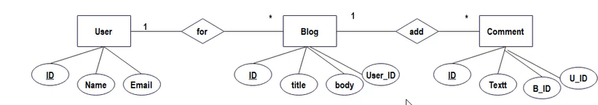
ER Diagram

Slide 12
User Roles
1.Admin
Permissions: Full Access
Manage all users (add/edit/delete)
Create, edit, publish, or delete any blog post
Approve or moderate comments
Manage site settings (theme, SEO, performance, etc.)
Access analytics and performance reports
Control newsletters, ads, and monetization tools
2. Editor
Permissions: Content Management
Create, edit, and publish posts (own and others')
Review and approve drafts submitted by authors
Assign articles to writers
Moderate comments
Tag and categorize content for SEO and usability

Slide 13
3. Author / Contributor
Permissions: Limited Content Creation
Create and edit their own blog posts
Submit drafts for editorial review
View feedback or comments on their content
Cannot publish directly without editor/admin approval
4. Registered User / Subscriber
Permissions: Read & Engage
Read blog content
Like or bookmark posts
Comment and engage in discussions (if approved)
Subscribe to newsletters or push notifications
Save favorite articles for later

Slide 14
5. Guest / Visitor
Permissions: Read-Only Access
Browse public content freely
Cannot comment or engage without registering
Encouraged to sign up for additional features like commenting, newsletters, and personalized recommendations

Slide 15
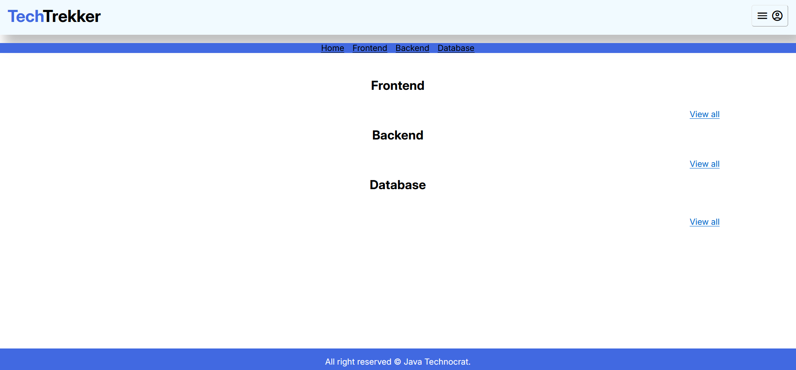
Landing Page

Slide 16
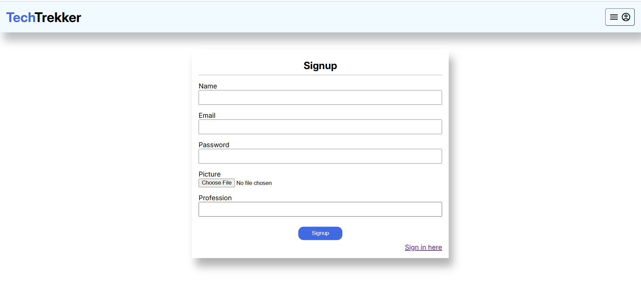
Singup Page

Slide 17
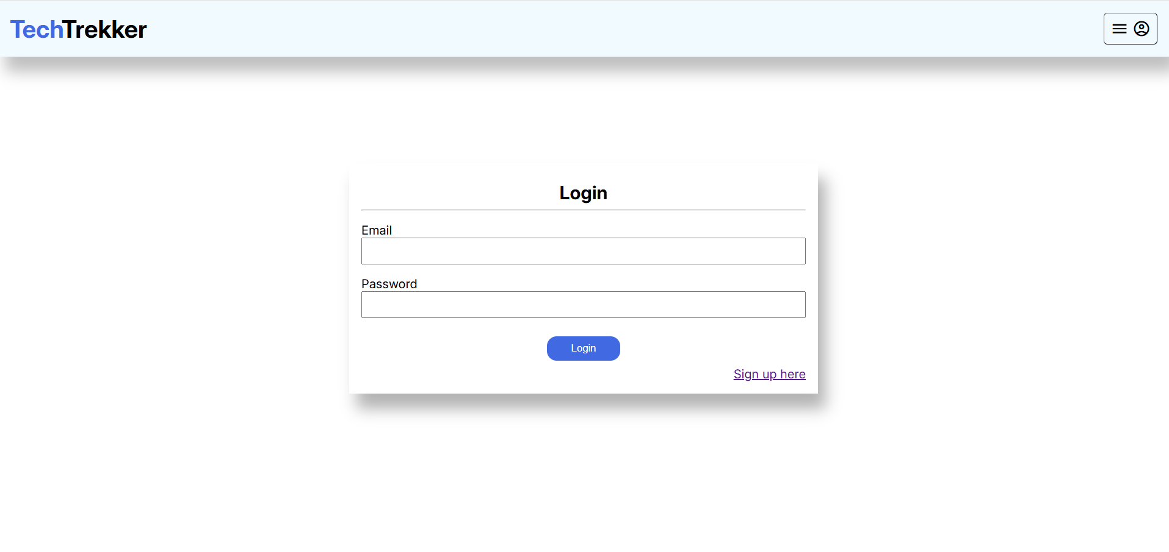
Log in Page

Slide 18
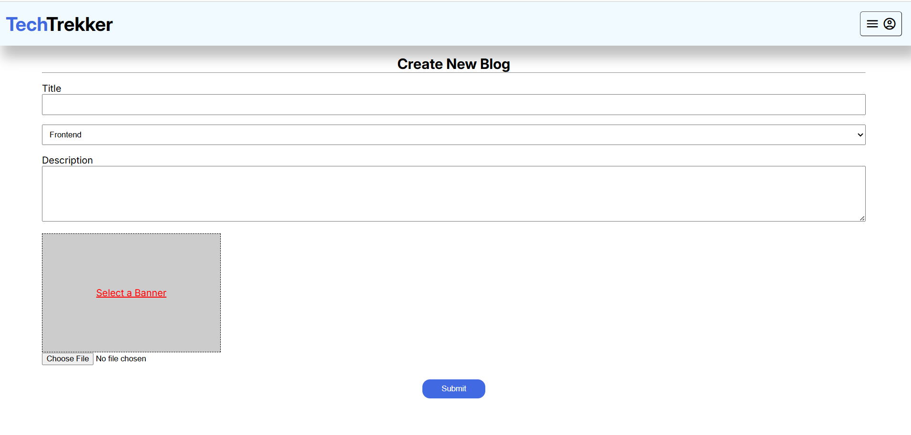
Create Blog Page

Slide 19
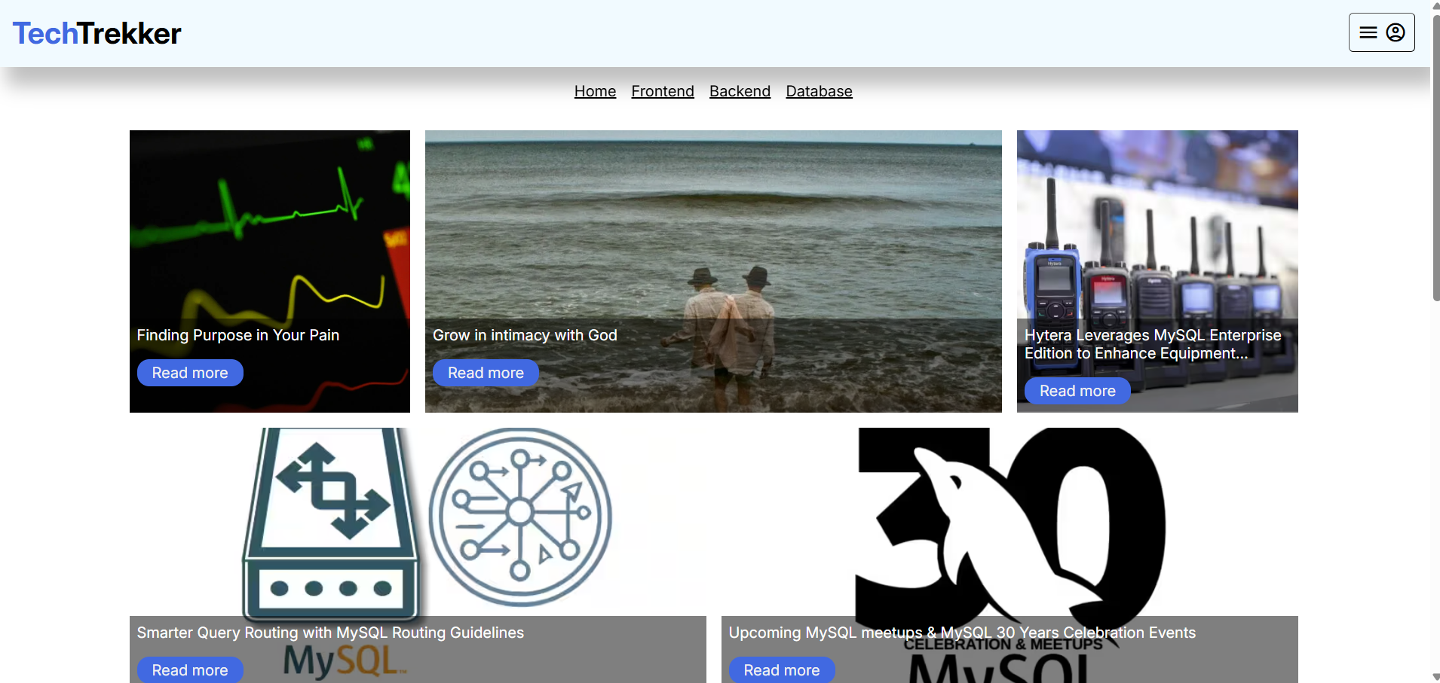
Home Page

Slide 20
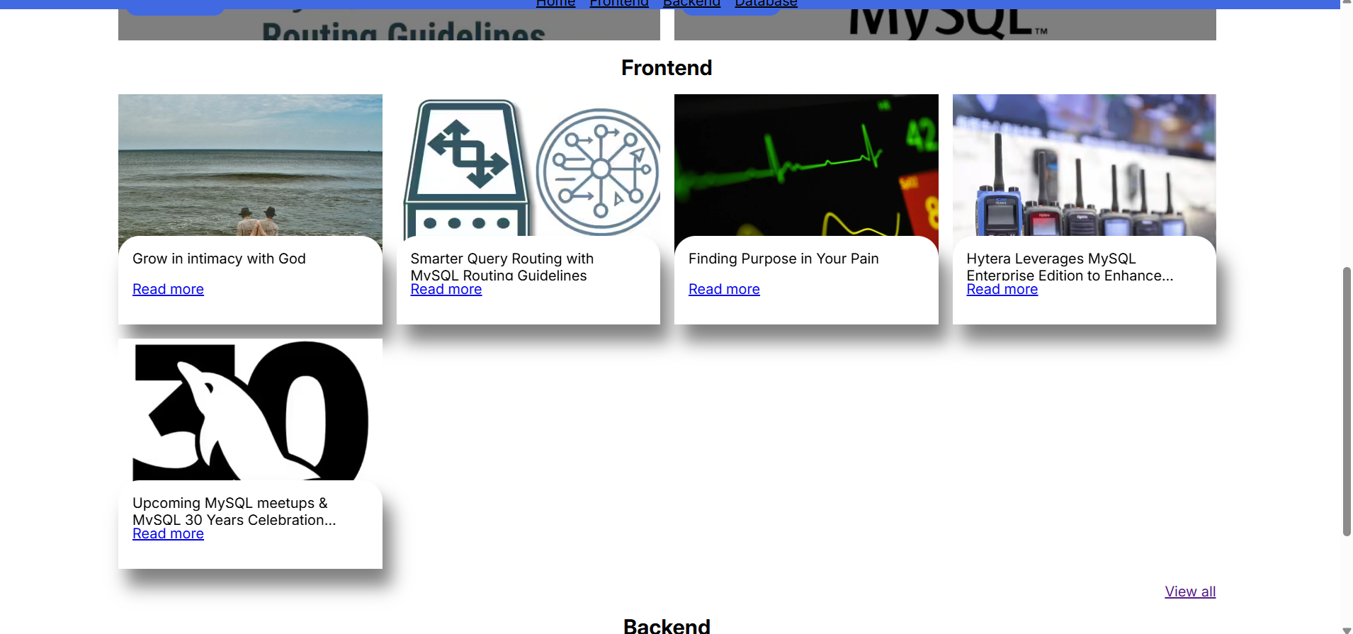
Fronted Page

Slide 21
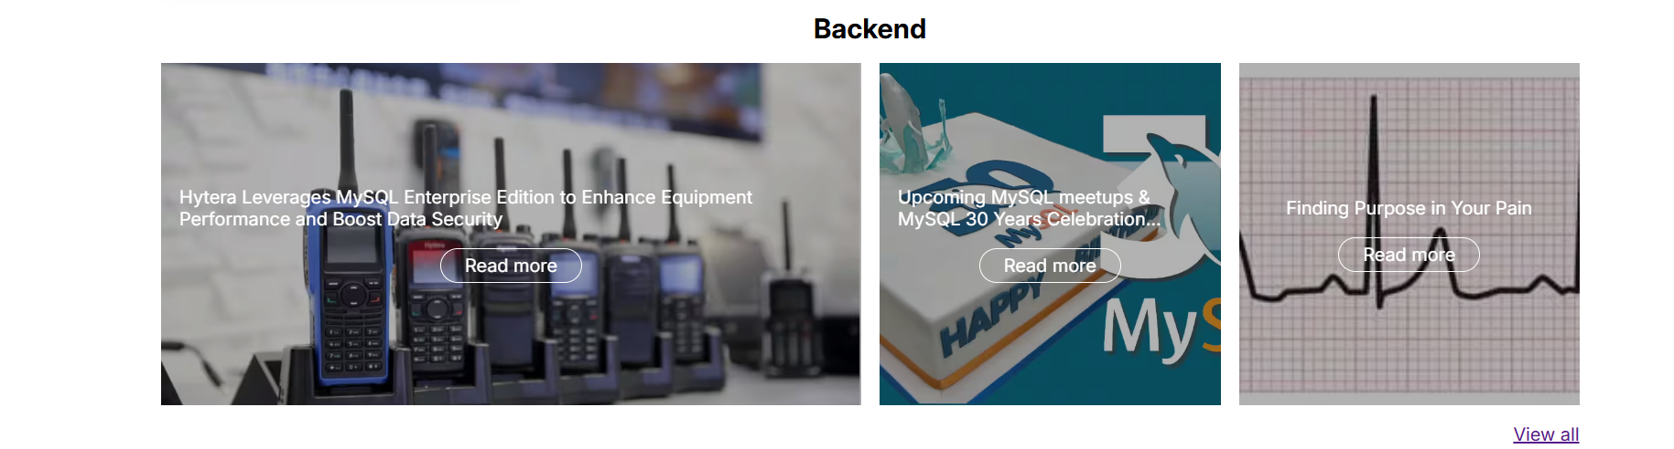
Backend Page

Slide 22
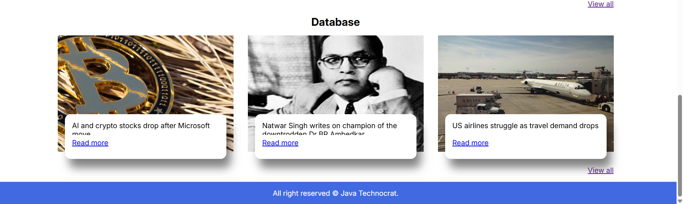
Database Page

Slide 23
Benefits of Tech Teckker
Tech Teckker is designed not just as a content platform, but as a valuable resource for tech enthusiasts, learners, and professionals. Here are the core benefits it offers:
1. Centralized Tech Knowledge Hub
Readers can access a wide range of topics — from gadget reviews to AI and cybersecurity — all in one place, saving time and effort.
2. Learning Made Easy
Simplified tutorials, how-to guides, and explainers make it easier for beginners to understand complex tech concepts and tools.
3. Stay Updated with Trends
Frequent updates and curated news help users stay current with fast-changing technology trends, product launches, and innovations.

Slide 24
4. Informed Decision Making
Detailed comparisons, honest reviews, and buying guides help users make smarter choices when purchasing tech products or services.
5. Engaged Community
Interactive features like comments, discussions, and forums allow users to connect, share opinions, and learn from each other.
6. Professional Growth
Aspiring tech writers and contributors can showcase their knowledge, build a portfolio, and gain visibility within the tech space.
7. SEO & Developer Friendly Platform
With a strong backend and optimized performance, the site is scalable, fast, and well-suited for both readers and contributors.
8. Personalized Experience
Through subscriptions, bookmarks, and user profiles, readers enjoy a tailored experience based on their interests.

Slide 25
9. Mobile-Ready Access
Fully responsive design ensures users can engage with content on-the-go from any device, anywhere.
10. Monetization Opportunities (Admin/Owner)
Admins can integrate ads, sponsored content, and affiliate marketing for revenue generation while offering valuable content to users.

Slide 26
Future Enhancement
To ensure continuous growth, innovation, and an improved user experience, the following future enhancements are planned for Tech Teckker:
1. Mobile App Development
Launch dedicated Android and iOS mobile apps for better accessibility, push notifications, and a more immersive reading experience.
2. AI-Powered Content Suggestions
Implement AI-based recommendation systems to deliver personalized article suggestions based on user behavior and interests.
3. Voice Search Integration
Add voice-enabled search functionality to enhance accessibility and convenience, especially for mobile users.

Slide 27
4. Multilingual Support
Expand the blog’s reach by offering multi-language support, making content accessible to a global audience.
5. Author Profiles & Portfolios
Introduce detailed contributor profiles with article history, bio, social links, and follower count to encourage engagement and recognition.
6. Interactive Media Integration
Include podcasts, video reviews, livestreams, and infographics to make the content more dynamic and diverse.
7. Community Forums & Q&A Section
Build an active tech discussion forum or Stack Overflow-style Q&A space to foster deeper community involvement and problem-solving.
8. Newsletter Automation with AI
Use AI to auto-generate custom weekly or monthly newsletters based on users’ favorite topics and read history.

Slide 28
Challenges and Solution
Launching and managing a tech blog like Tech Teckker comes with a range of challenges. Below are some of the key issues and the strategies proposed to overcome them:
1. Challenge: Content Consistency
Maintaining a steady flow of high-quality, up-to-date content is time-consuming and requires a team effort.
Create a content calendar to plan and schedule posts in advance.
Encourage guest posts and contributions from the tech community.
Use AI tools for idea generation and topic research.
2. Challenge: Standing Out in a Crowded Market
The tech blog space is highly competitive, with many established players.
Focus on niche content like tutorials, local tech news, or specific product segments.
Build a unique brand voice and offer in-depth, original analysis rather than just news reposts.
Leverage SEO best practices and target long-tail keywords.

Slide 29
3. Challenge: Driving Traffic and User Engagement
Attracting and retaining readers can be difficult in the early stages.
Promote content on social media, forums, and Reddit communities.
Implement email newsletters and push notifications.
Add interactive elements like polls, comment sections, and reader surveys.
4. Challenge: Managing Technical Aspects
Performance issues, bugs, and security concerns can affect the user experience.
Use a reliable CMS (like WordPress or a custom-built backend) with regular maintenance.
Ensure responsive design and optimize loading speed.
Implement security measures like SSL, backups, and firewalls.

Slide 30
5. Challenge: Monetization Without Compromising UX
Generating revenue while keeping the blog user-friendly and ad-light is a balancing act.
Use non-intrusive ads, affiliate links, and sponsored content.
Offer premium memberships for exclusive content and an ad-free experience.
Introduce product comparisons and buying guides with affiliate tie-ins.
6. Challenge: Keeping Up with Rapid Tech Evolution
Technology evolves quickly, making older content obsolete.
Regularly audit and update existing articles.
Use versioned content, indicating if the article is current as of a specific date.
Enable community suggestions or flags for outdated content.

Slide 31
Security Features
1.CSRF(Cross Site Request Forgery)
2.SQL injection
3. Bcrypt Encryption

Slide 32
Conclusion
Tech Teckker is more than just a blog — it's a platform built to inform, educate, and inspire anyone with a passion for technology. From delivering the latest tech news and product reviews to simplifying complex concepts through tutorials and explainers, the blog aims to bridge the gap between innovation and understanding.
With a user-friendly design, dynamic content strategy, and community-driven approach, Tech Teckker positions itself as a valuable resource for both beginners and tech-savvy users alike. By addressing common challenges and planning for future enhancements, the platform is well-prepared for long-term growth and engagement.
As technology continues to evolve, Tech Teckker will adapt and expand, striving to be at the forefront of digital exploration and conversation. The journey is just beginning — and the future looks bright, byte by byte.

Slide 33


